Slide 1

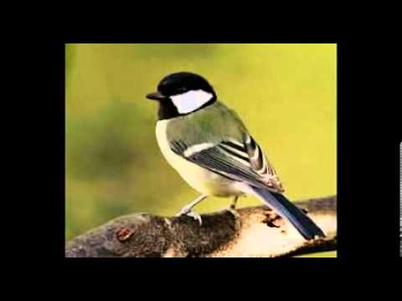
Twitter Sentiment Analysis
By Ashour Dankha & Viren Mody

Slide 2

Preprocessing: 3 Stages
Regex Stage:
Links
Accents/Non UTF-8 letters
Digits
Hashtags
Punctuations
Stop Words Stage:
Removed All Stop Words (Using a NLTK Library)
Stemmer Stage:
Used a library (Porter Stemmer + One other) to get root of words. (i.e. Having -> hav)

Slide 3
Classification Stage
Evaluated multiple models (10+) and found/used the one with highest F-Score(s)
Tuned parameters to achieve higher scores for each individual model.
Cross Validation was 10, as per request.

Slide 4
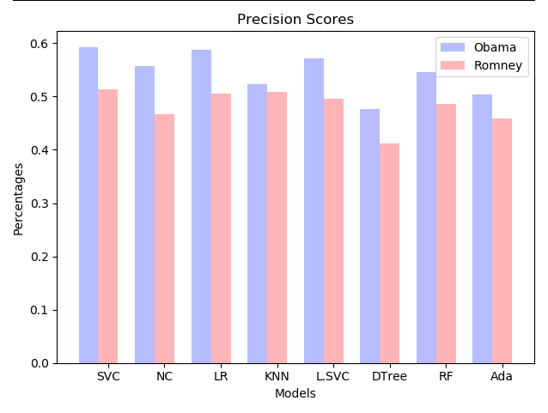
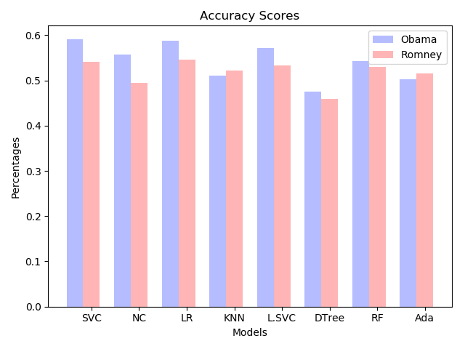
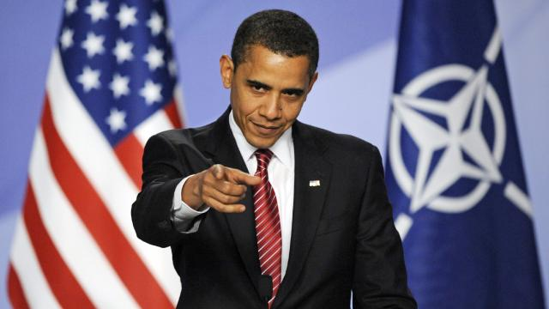
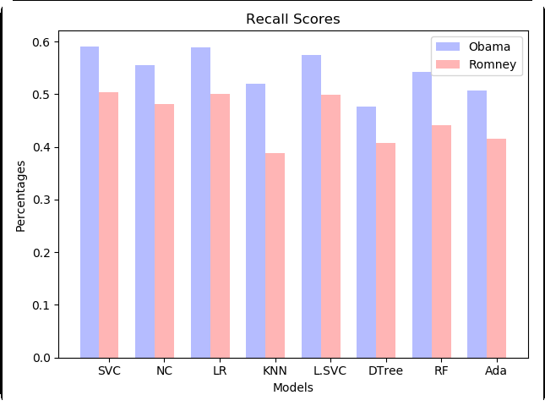
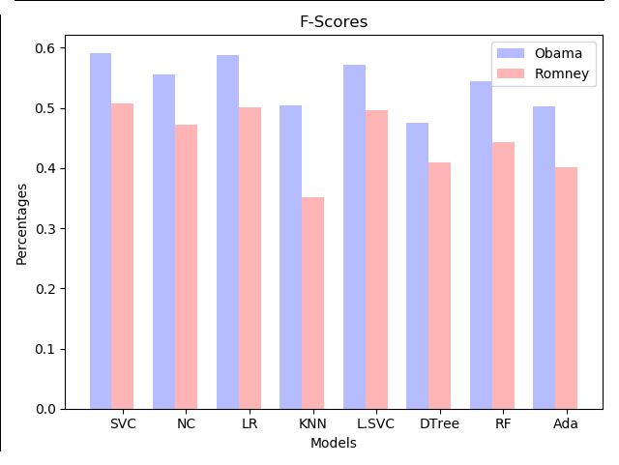

Slide 5
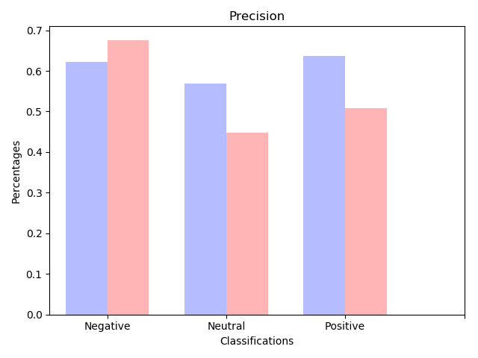
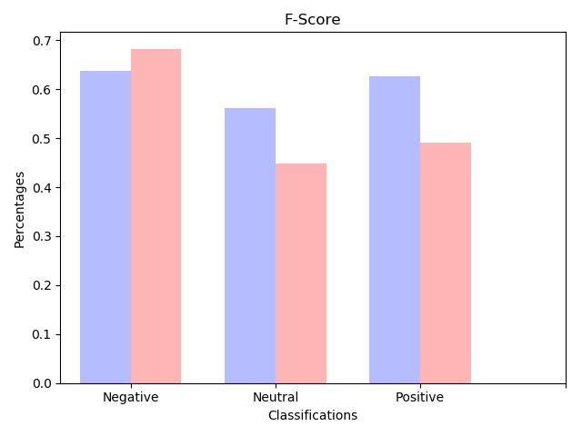
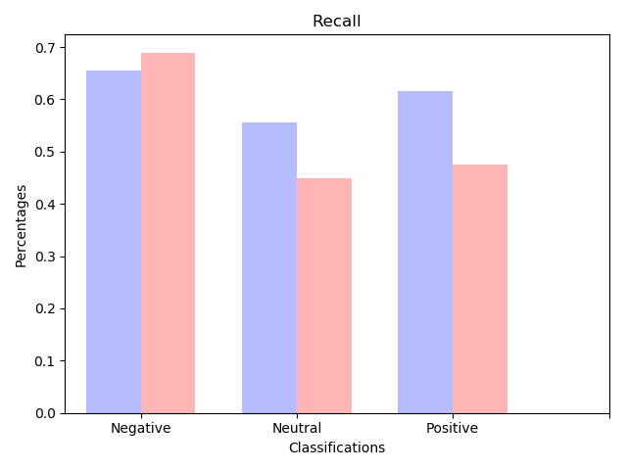
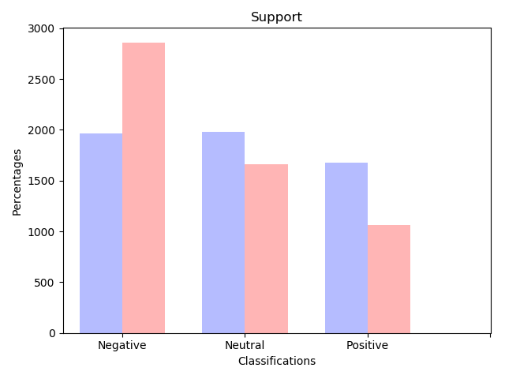

Slide 6
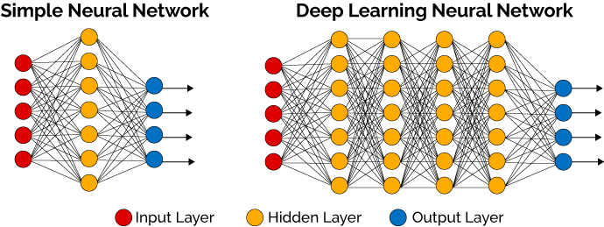
Current/Future Strategies and Goals
Figure out better parameters for each model given our dataset.
Use other Vectorization Algorithms/Strategies to create features.
Find other stemmer algorithms that work well with Tweets.
Try to optimize run-time as things are a bit slow with a cv=10.
Achieve 75% F-Score averages without Deep-Learning.
Try out some Deep Learning Strategies (if time permits)

